Slide 1
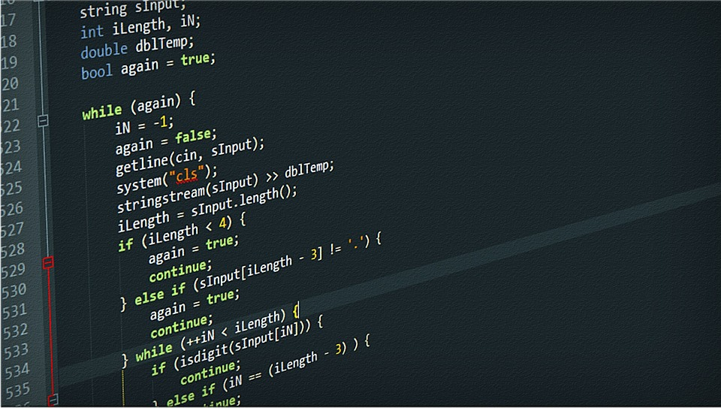

VSEC202: Python Programming
Instructor: Aditya Ganesh
Prime Minister’s Research Fellow
IITB–Monash Research Academy
Email: 22d2017@iitb.ac.in

Slide 2
Know your instructor: Aditya Ganesh
B.E.
Chemical Engineering from TSEC
Designed and developed a Slurry Bubble column reactor
M. Tech.
Chemical Engineering from IIT Jodhpur
Designed a Photocatalytic Reactor – Did CFD studies in ANSYS Fluent
Joint Ph.D.
Chemical / Mechanical & Aerospace from IITB–Monash
Studying the behaviour of polymers in turbulent flows. Extensive FORTRAN programming
Developed codes in Octave (Free version of MATLAB)
Developed a Heat Exchanger Network for IOCL to predict fouling. Extensive Python programming
Recipient of the Prime Minister’s Research Fellowship

Slide 3
What is programming?

Slide 4

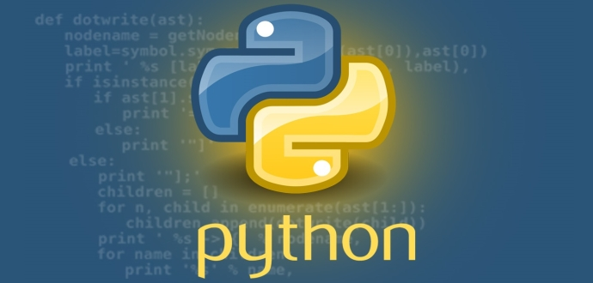
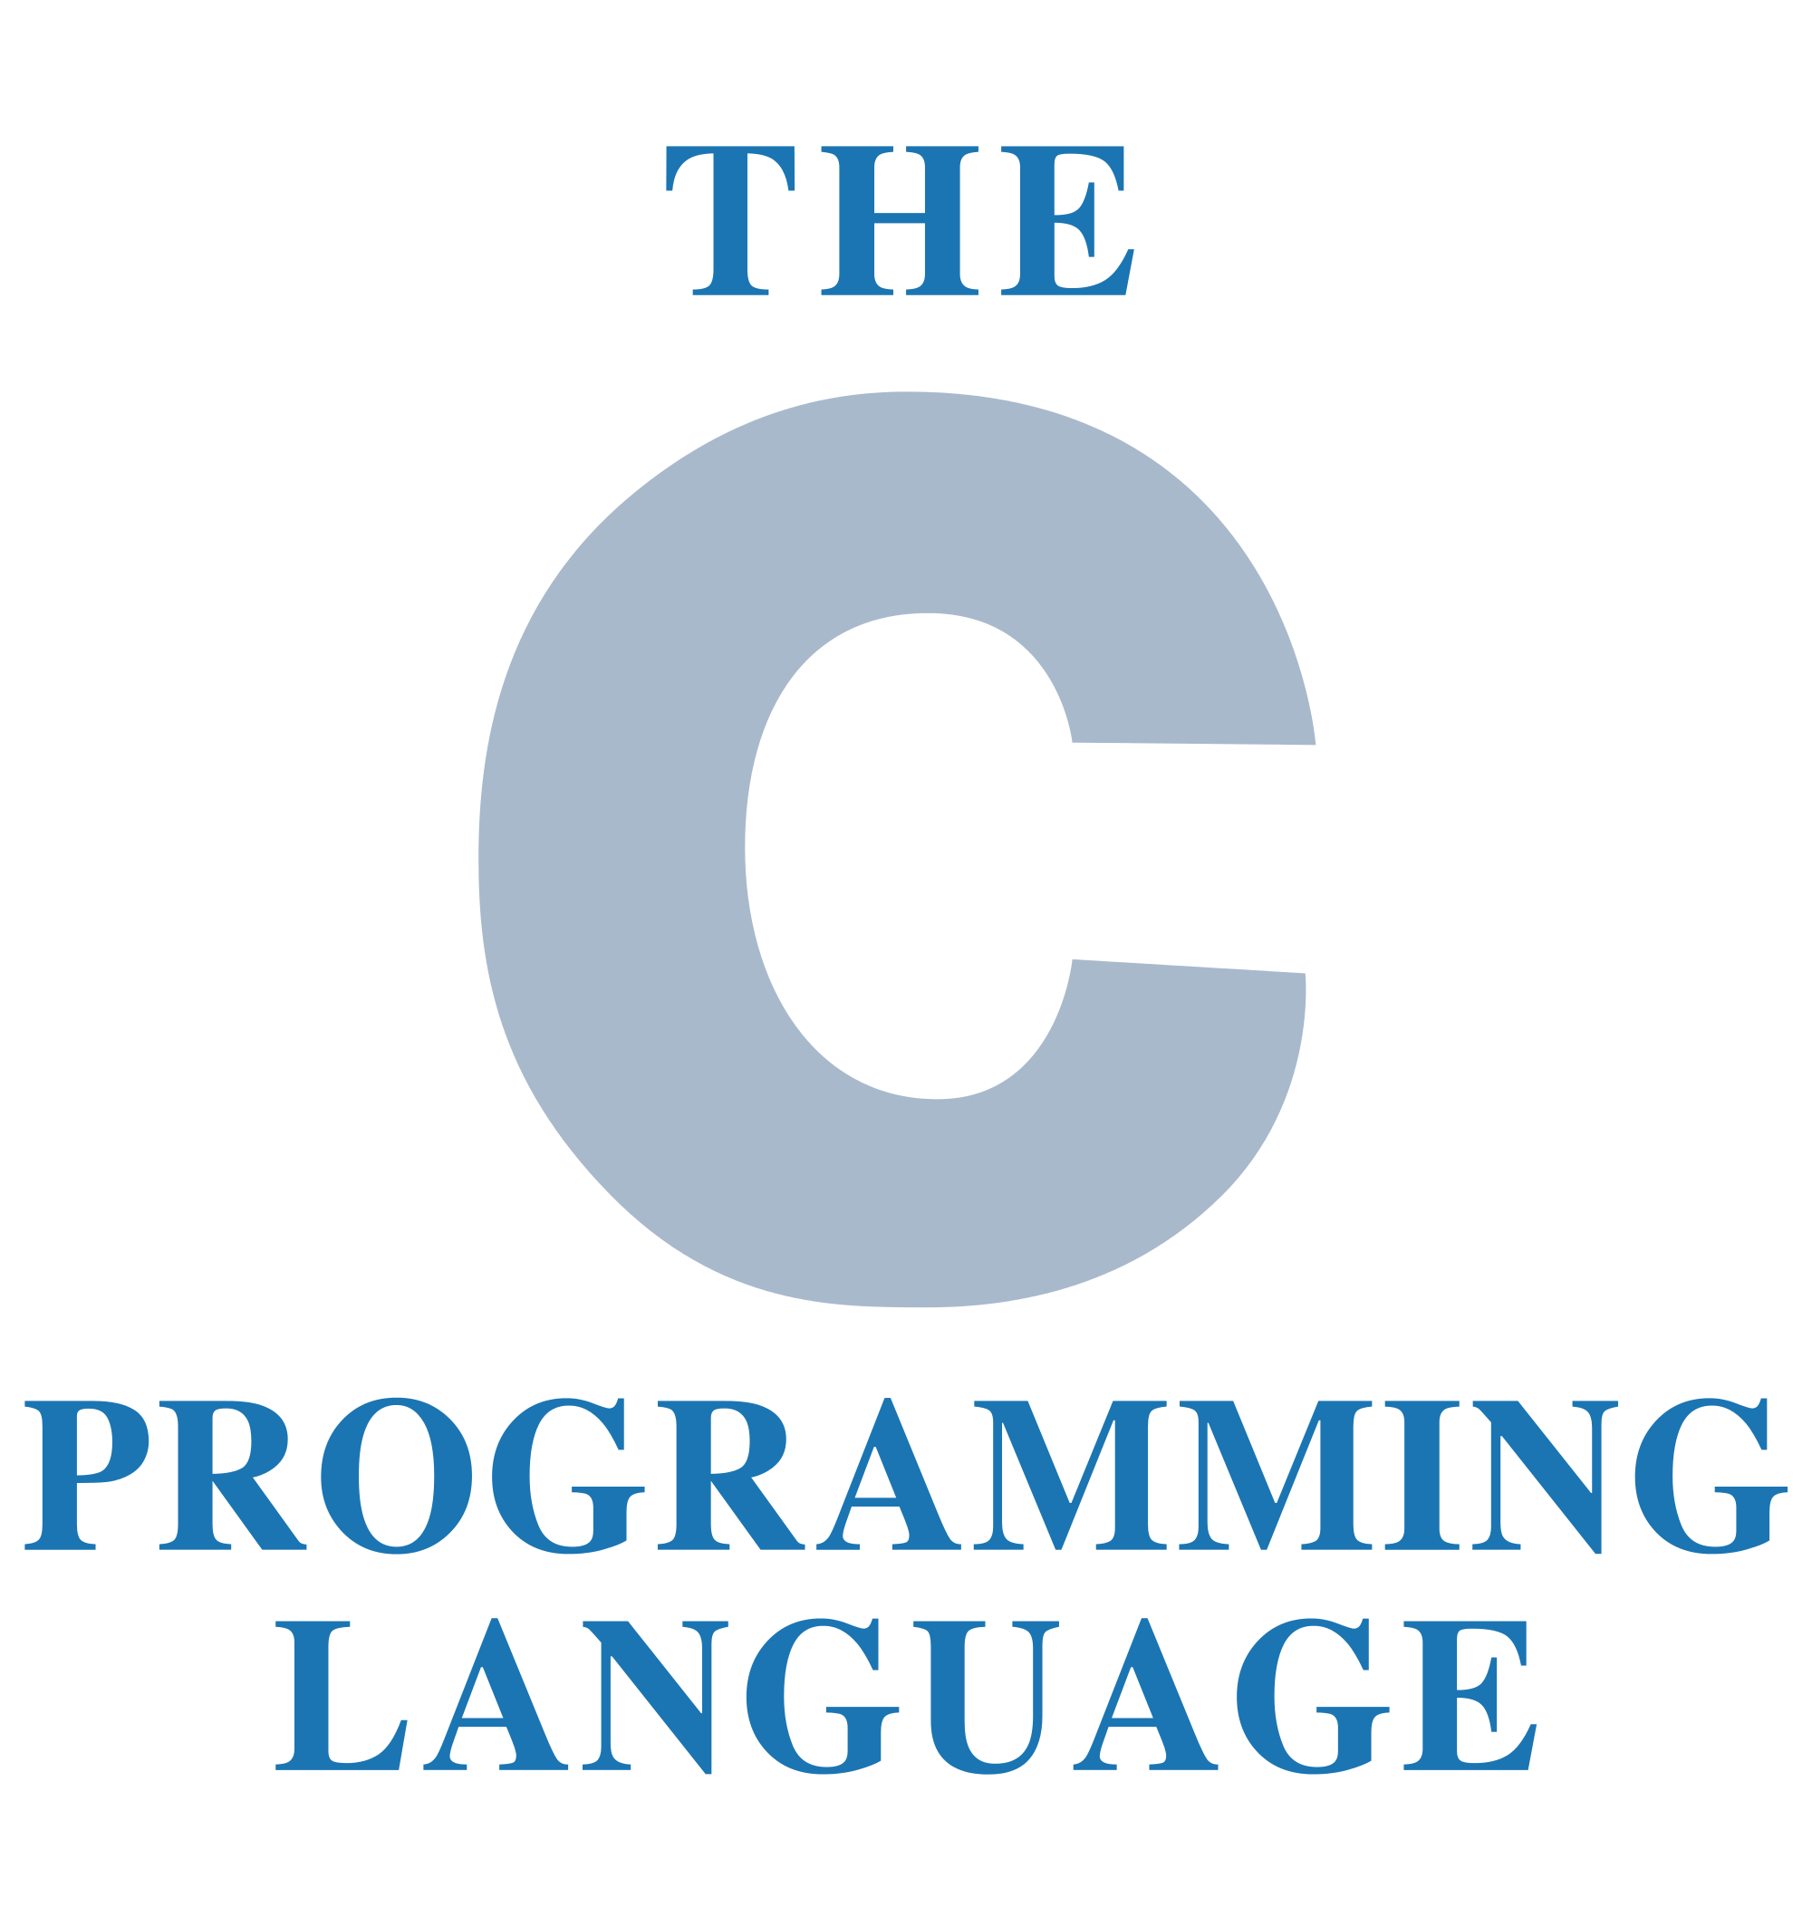

Programming
Programming = giving instructions to a computer to perform tasks.
Programs are written in a language computers can understand (e.g., Python, C, Fortran).
This Photo by Unknown Author is licensed under CC BY-SA

Slide 5
print(“Hello, World!”)

Slide 6

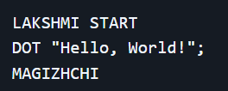
print(“Hello, World!”)
Ref: aadhithya/rajiniPP: Programming language based on Iconic dialogues of Rajinikanth. 🤘🏽

Slide 7
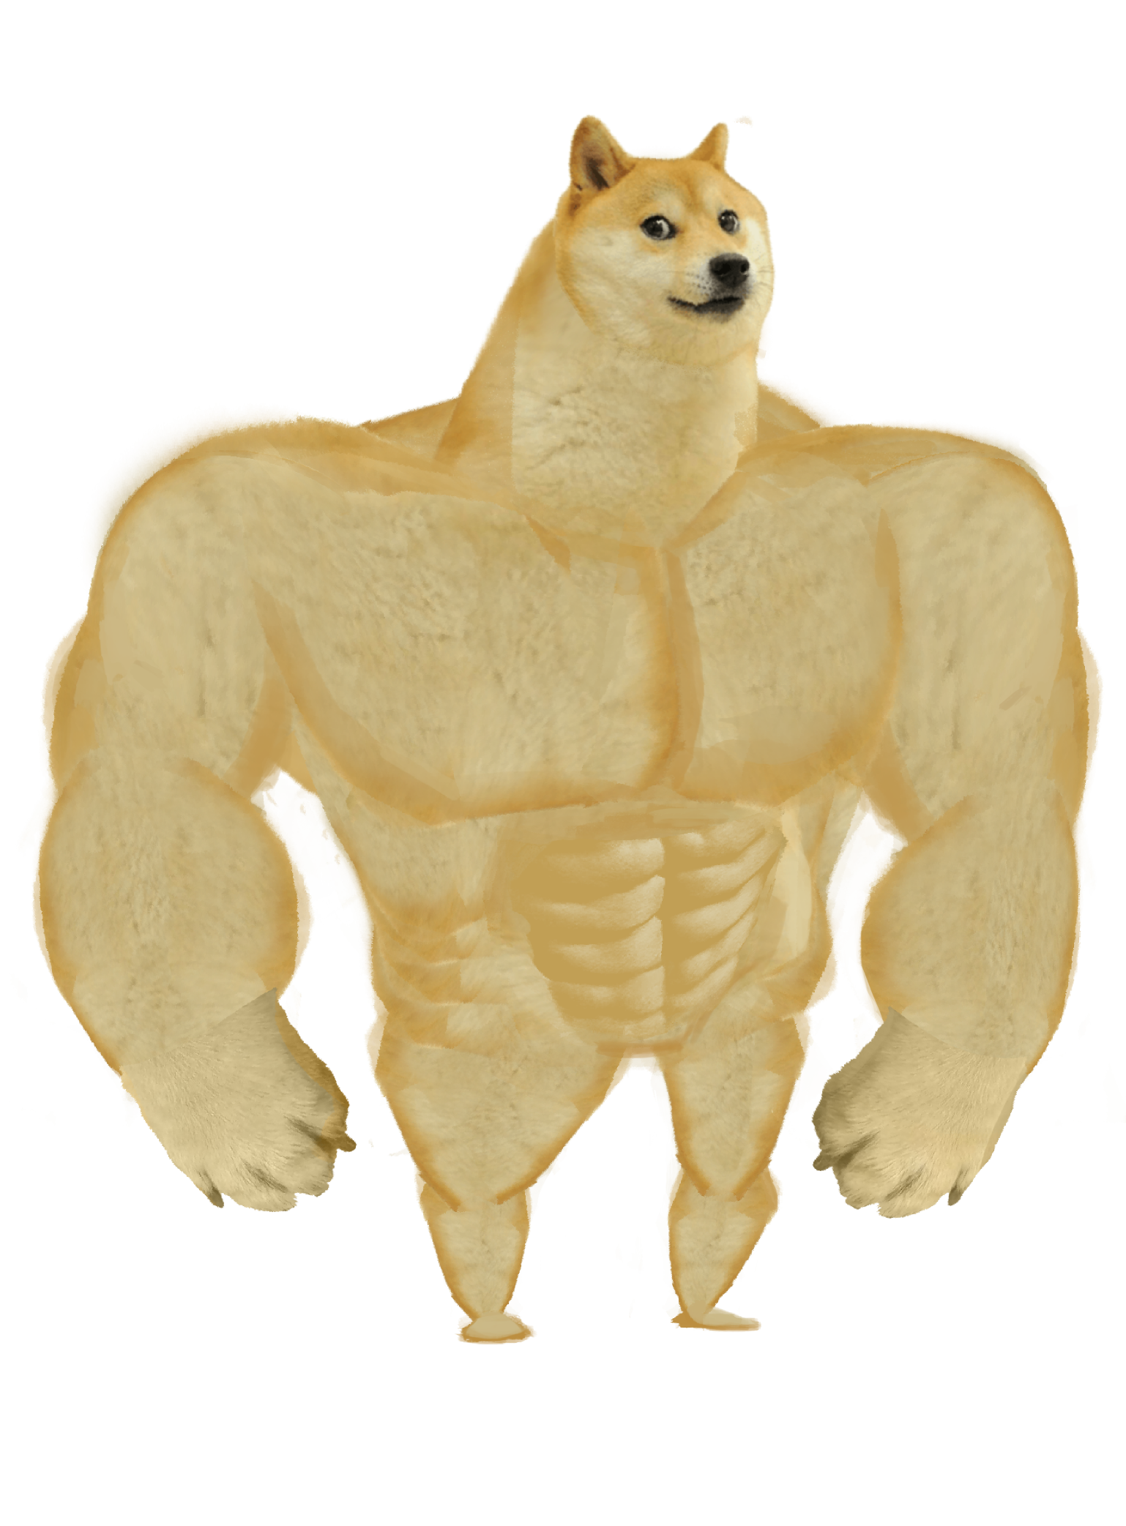
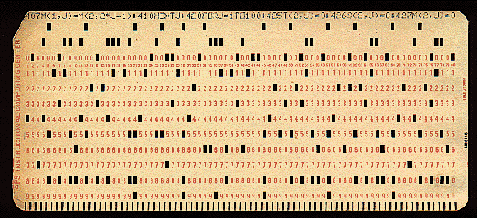
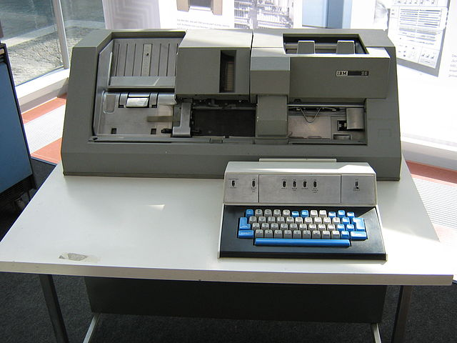
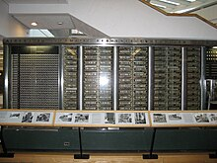
How programming was done before computers were “modern”
Writing code in multiple punchcards
Punch machines
These cards were fed to the computer

Slide 8
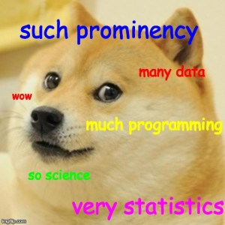

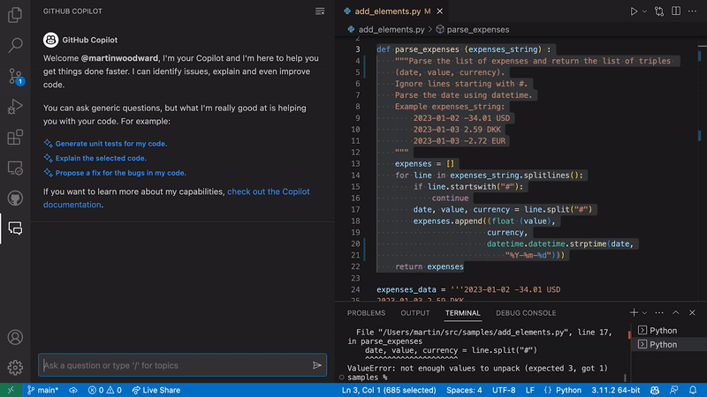

Programming now…
Github Copilot
ChatGPT

Slide 9
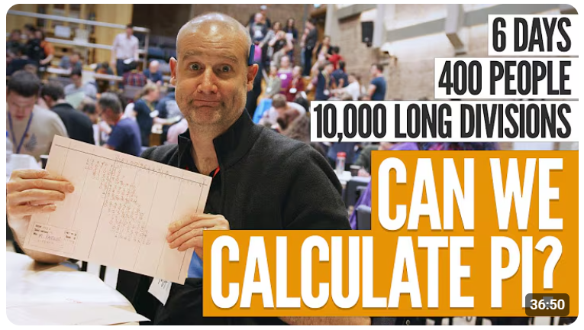
Why learn programming?
Simplest answer: You learn to stop wasting time, LoL
Few milliseconds on the computer
Video Ref: The biggest hand calculation in a century [Pi day 2024] https://youtu.be/LIg-6glbLkU?si=T0yUZg27rQDn1zll

Slide 10

You need to learn programming!

Slide 11
Understanding Basic concepts
(On a serious note…)

Slide 12
Algorithms
Sequence of steps used to solve a problem
Eg – Baking a cake, Tying your shoelace, etc.
Algorithm to make tea:
boil water → add tea leaves → pour milk → serve.

Slide 13
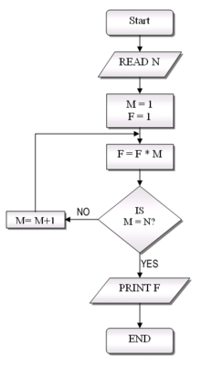
Flowcharts
Visual representation of an algorithm using symbols.
Oval/Parallelogram = Start/End,
Rectangle = Process,
Diamond = Decision.

Slide 14
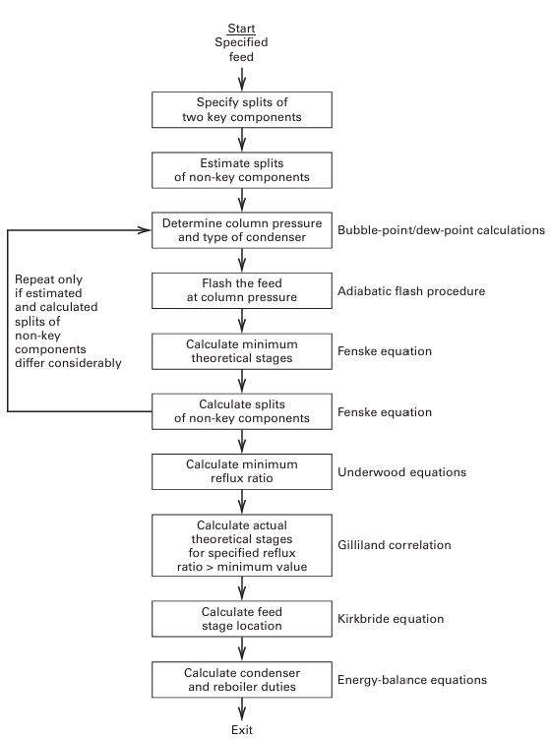
Flowcharts
Flowchart for Multi-component Distillation:
Fenske-Underwood-Gilliland Equation
Ref: Separation process principles, Seader, Henley and Ropar (2021)

Slide 15
Pseudocode
Human-readable outline of a program logic.
Example
START
INPUT two numbers
CALCULATE sum
DISPLAY result
END

Slide 16
Problem solving skills:
How do you think logarithms are calculated in your calculator?

Slide 17


How are logarithms calculated in your calculator?
Logarithmic series
Or
Eg: for ln(2), x = 1 in the first series
To get an accuracy upto 11 decimal spaces = 36 terms!
Ref: SoME-3 | Summer of Math Exposition 3 - How does a computer/calculator compute logarithms?

Slide 18

How are logarithms calculated in your calculator?
Modified logarithmic series
Substituting u = (1+x)/(1-x) and after some rearrangements
Accuracy of 11 decimal places achieved in 8 terms!
Check it out here!: SoME 3 - Comparison of natural log series | Desmos

Slide 19
Basic Syntax and Data Types

Slide 20
Variables
name = “Aditya”
age = 19
Freshie = True

Slide 21
Data Types
int → whole numbers (10, -5)
float → decimal numbers (3.14, -0.5)
str → text ("Hello")
bool → True/False

Slide 22
Operators
Arithmetic: +, -, *, /, %, **
Comparison: ==, !=, <, >, <=, >=
Logical: and, or, not

Slide 23
Input/Output
Input example: name = input(“Enter your name: ”)
Output example: print(“Hello”, name)

